Slide 1
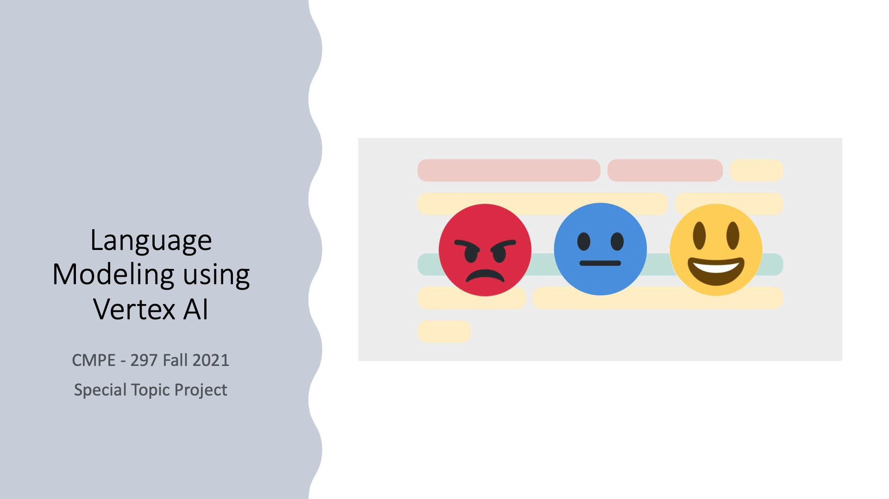

Slide 2
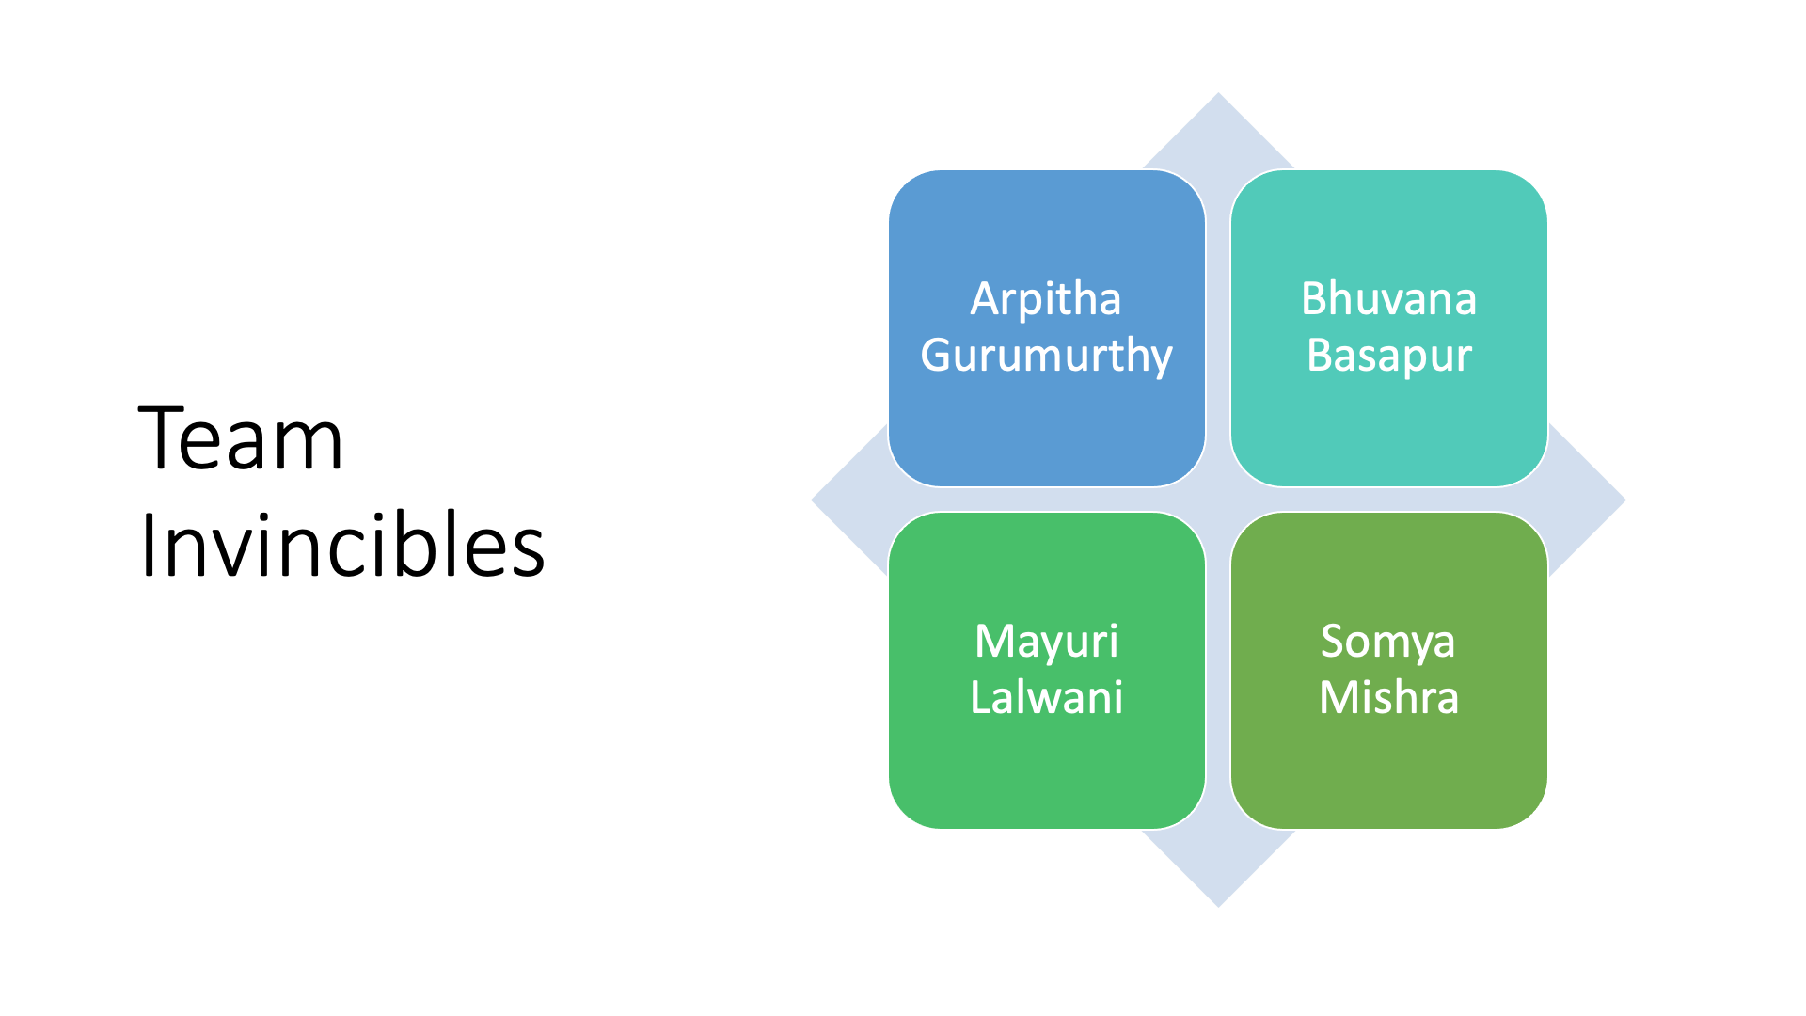

Slide 3
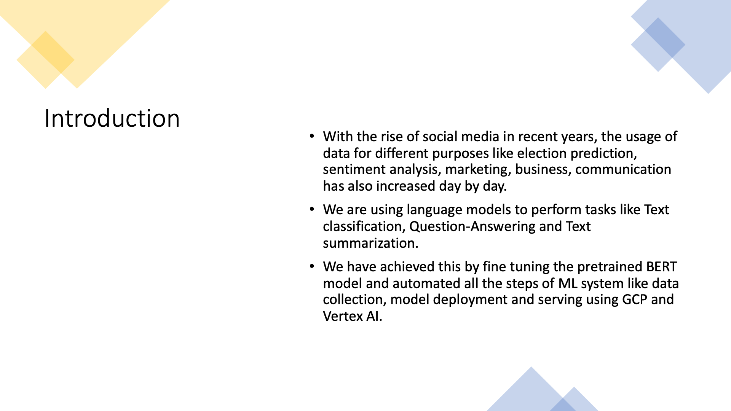

Slide 4
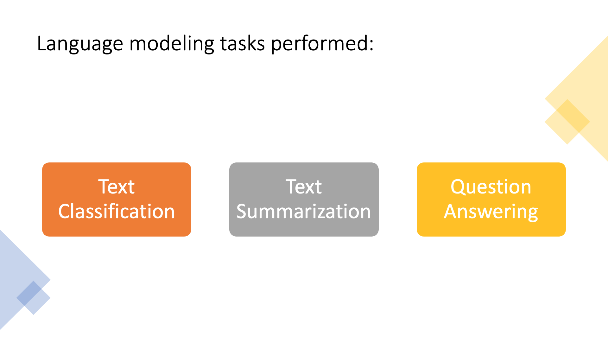

Slide 5
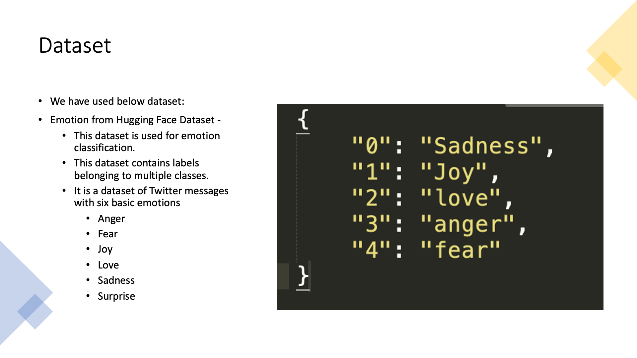

Slide 6
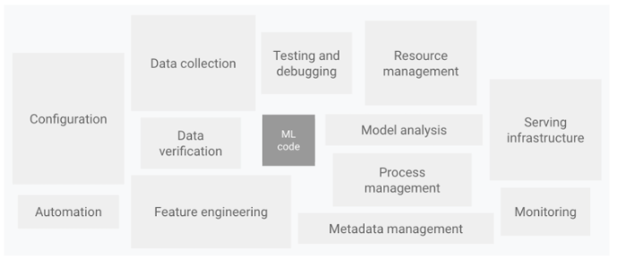
MLOps
Notes:
An ML Pipeline allows us to run and automate all the required steps of an ML system, starting from Data collection to model deployment and serving.

Slide 7
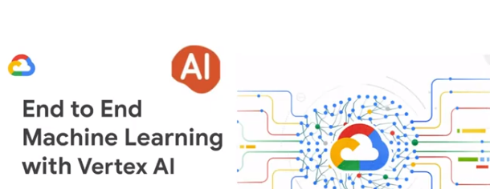
MLOps with GCP and Vertex AI

Slide 8
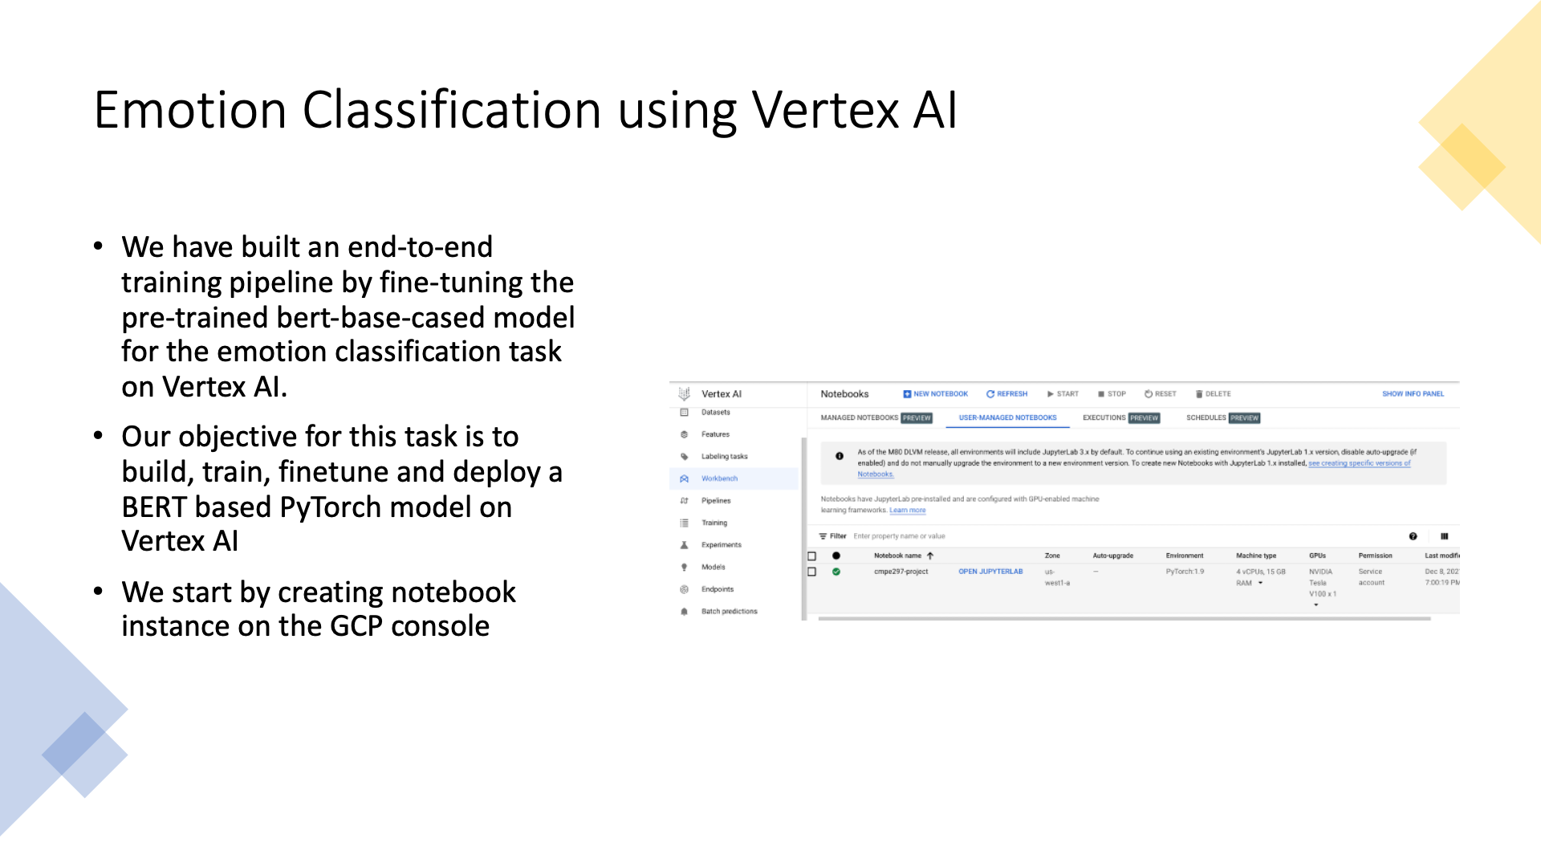

Slide 9
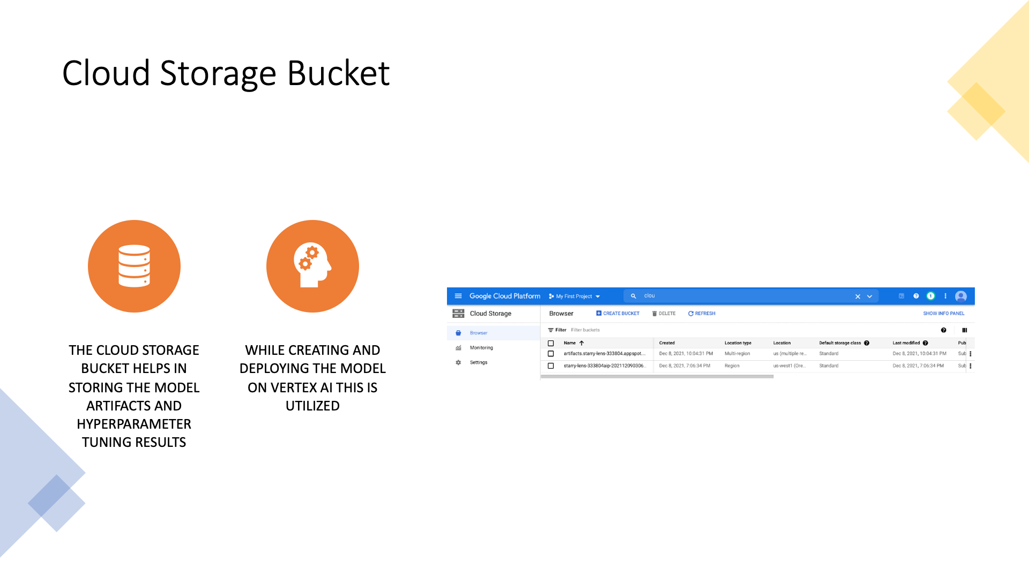
Notes:
We use a s3 bucket to store the model artefacts and hyperparameter tuning results which will be used while creating and deploying the model on vertexai.

Slide 10
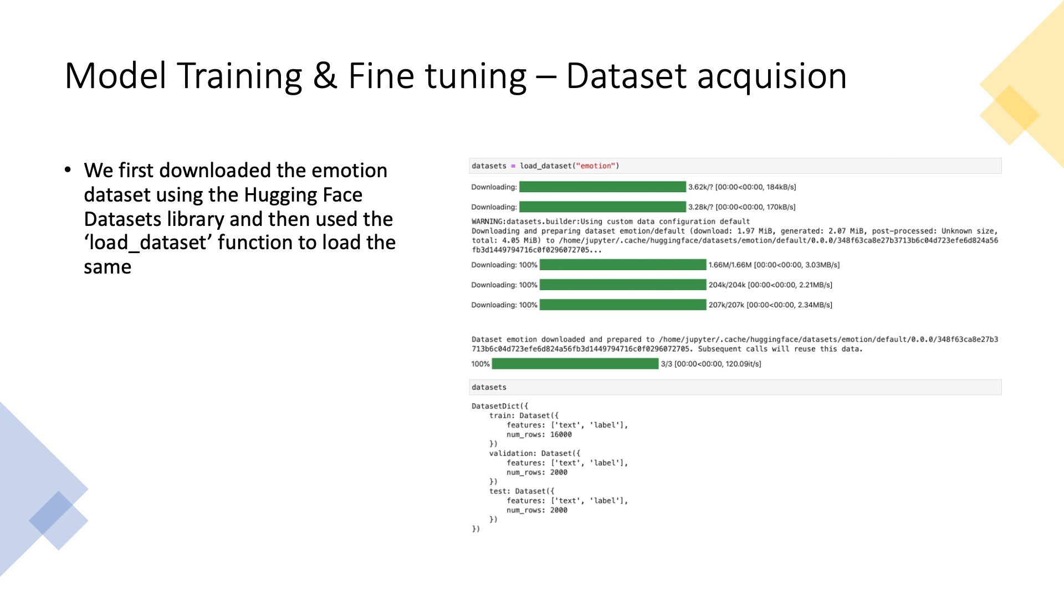
Notes:
We have locally implemented the model in a notebook to see if it works on the notebook. We used the “emotion dataset” from the Huggingface library and loaded it using the load_dataset function

Slide 11
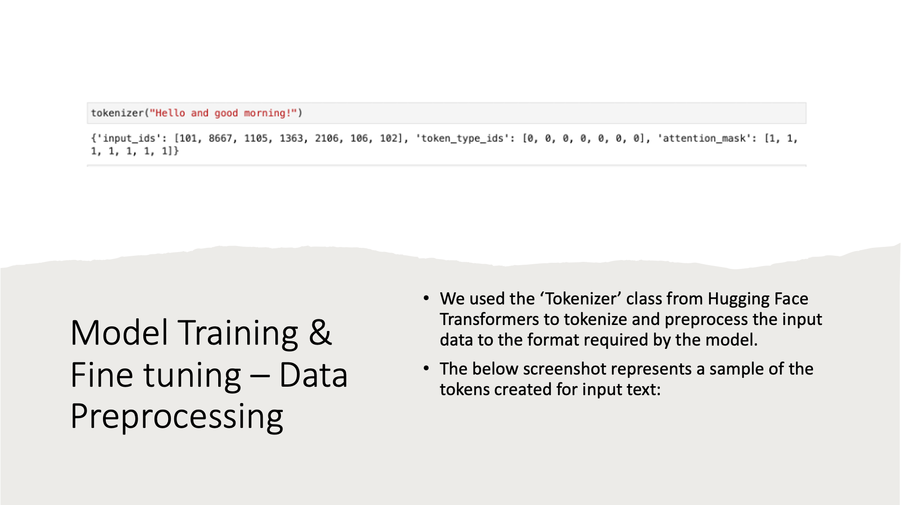
Notes:
We have used the tokenizer class from huggingface to tokenize and preprocess the input data to the format required by the model.​​The screenshot shows the tokens created for a sample sentence.

Slide 12
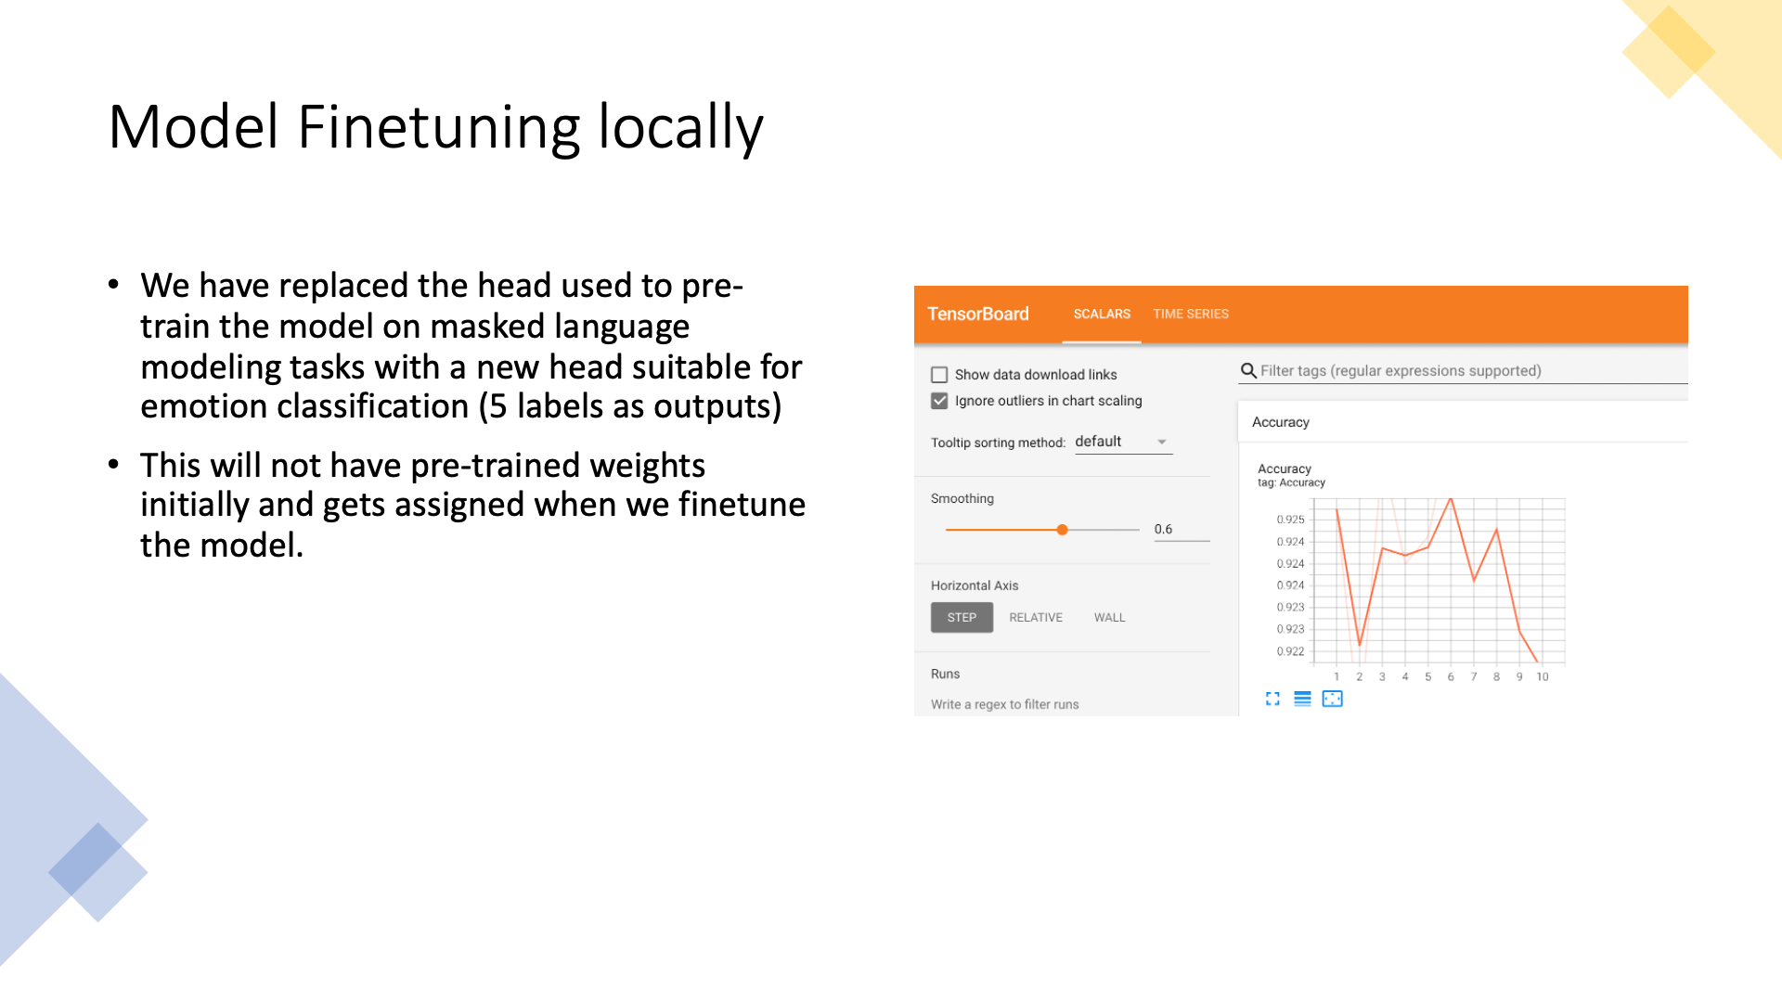

Slide 13
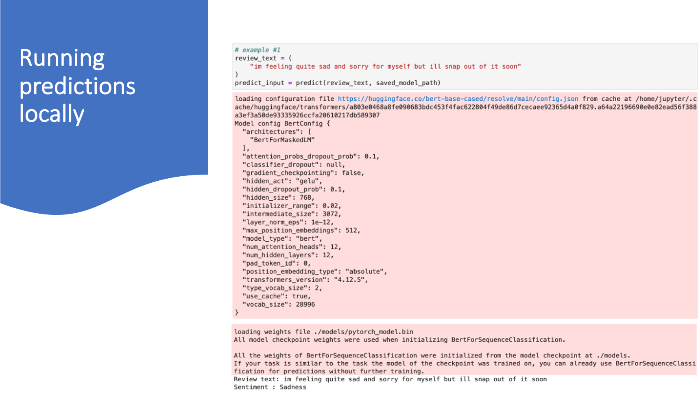

Slide 14
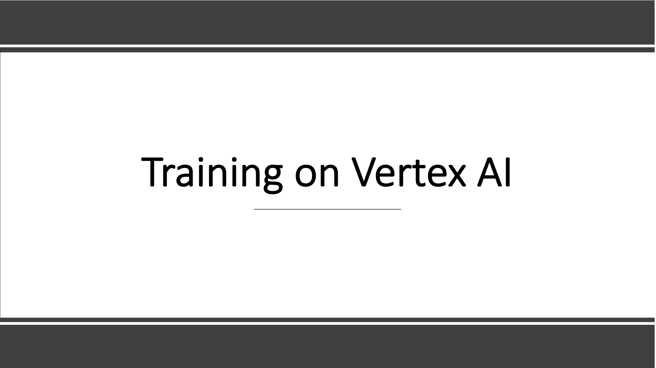

Slide 15
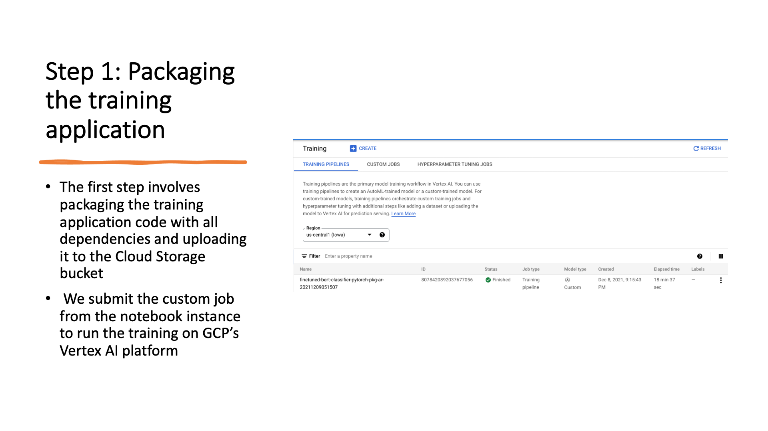

Slide 16
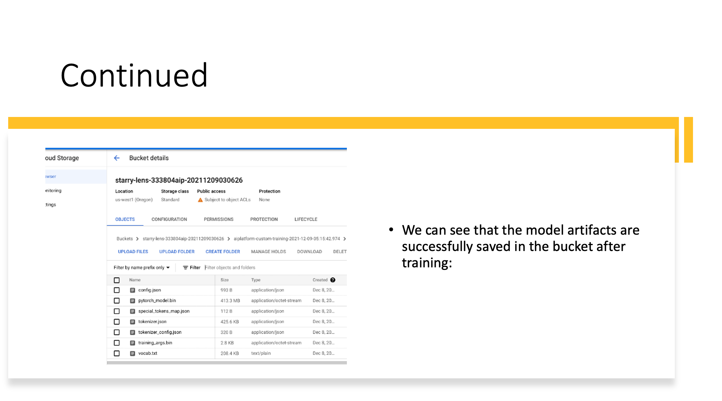

Slide 17
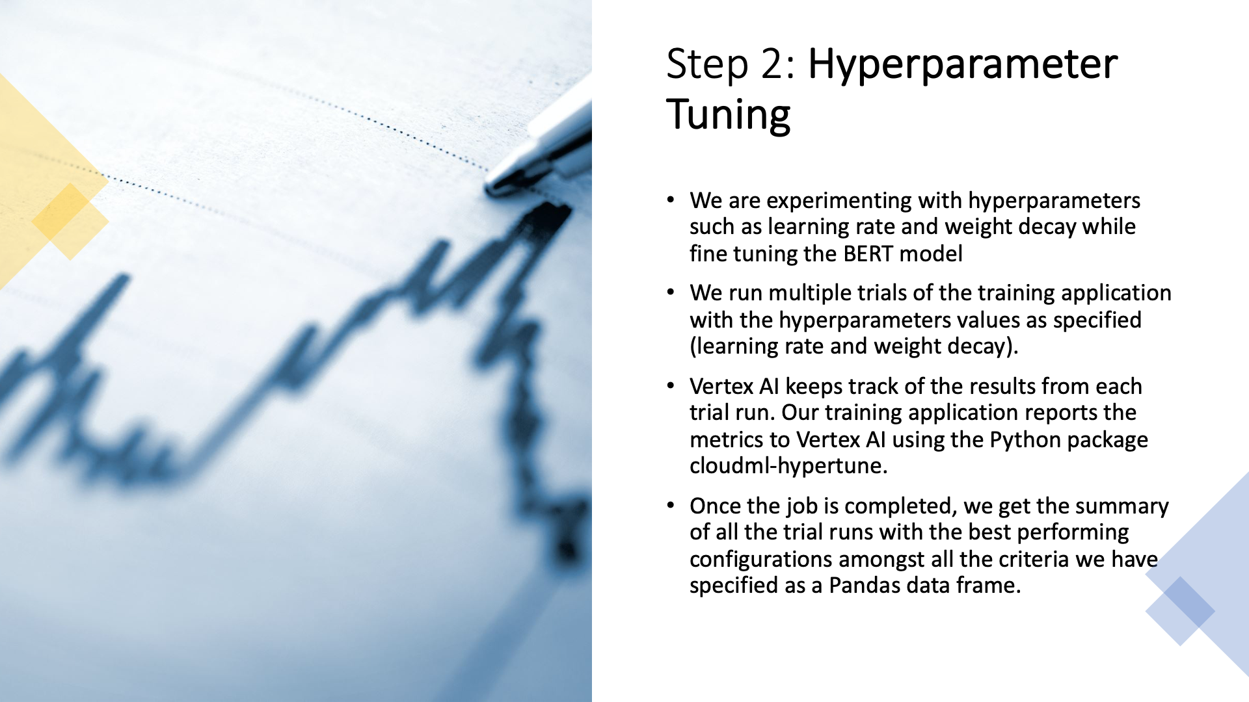

Slide 18
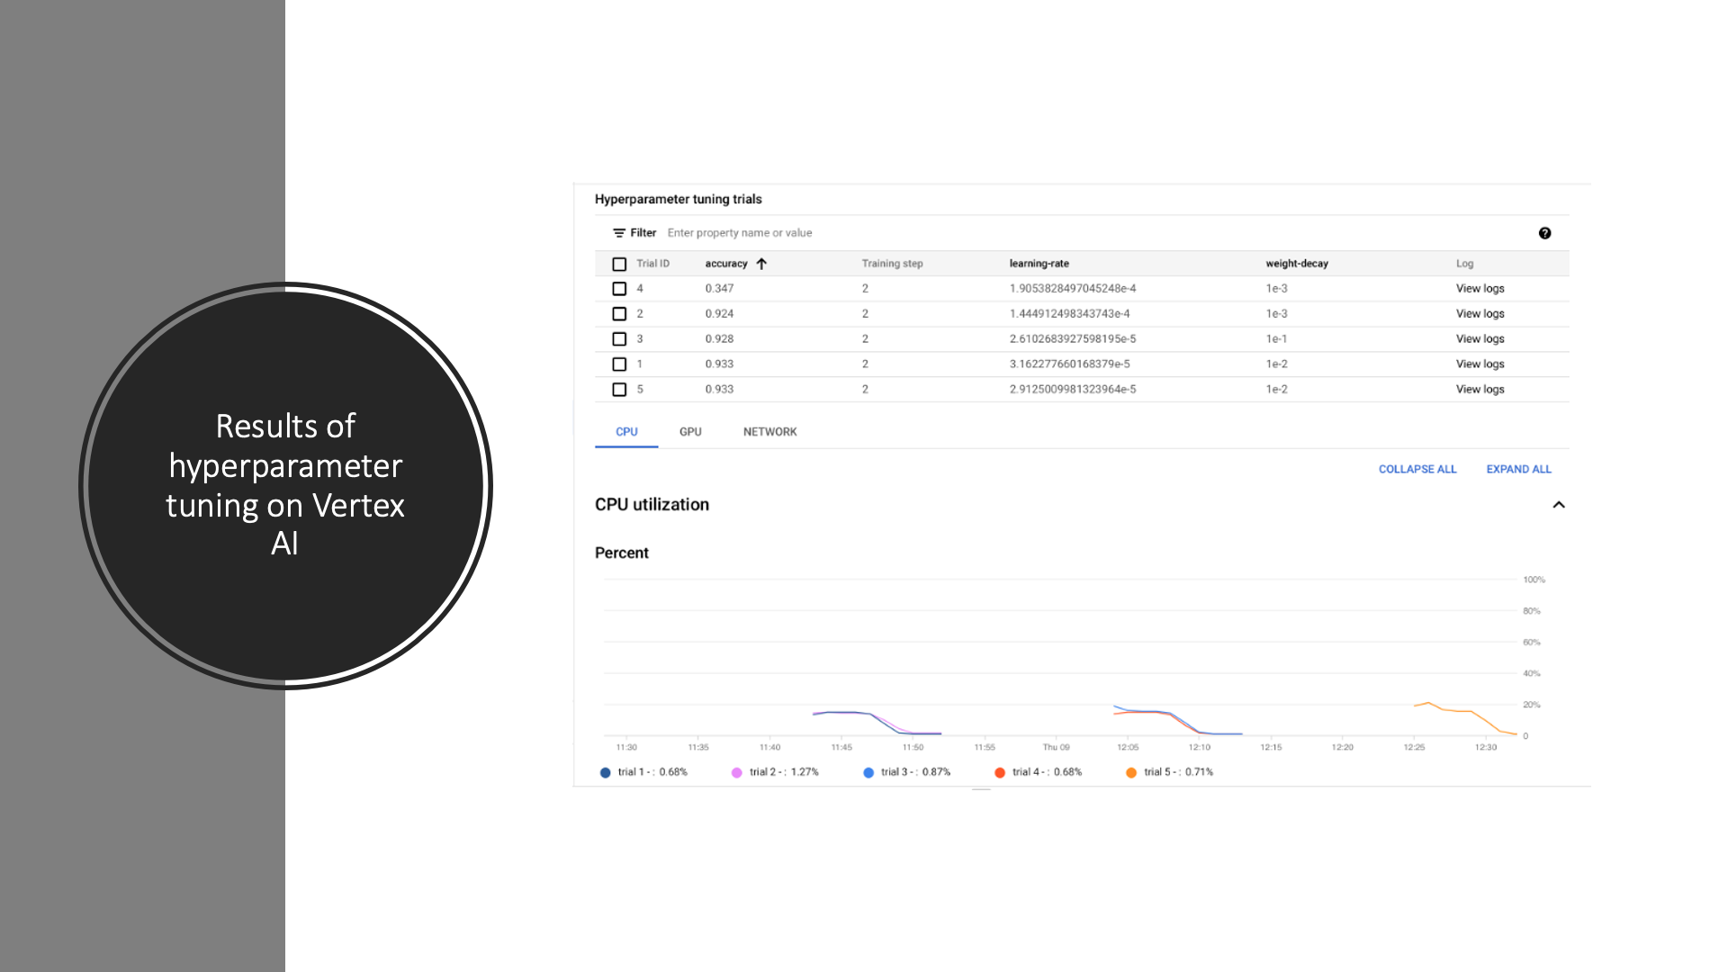

Slide 19
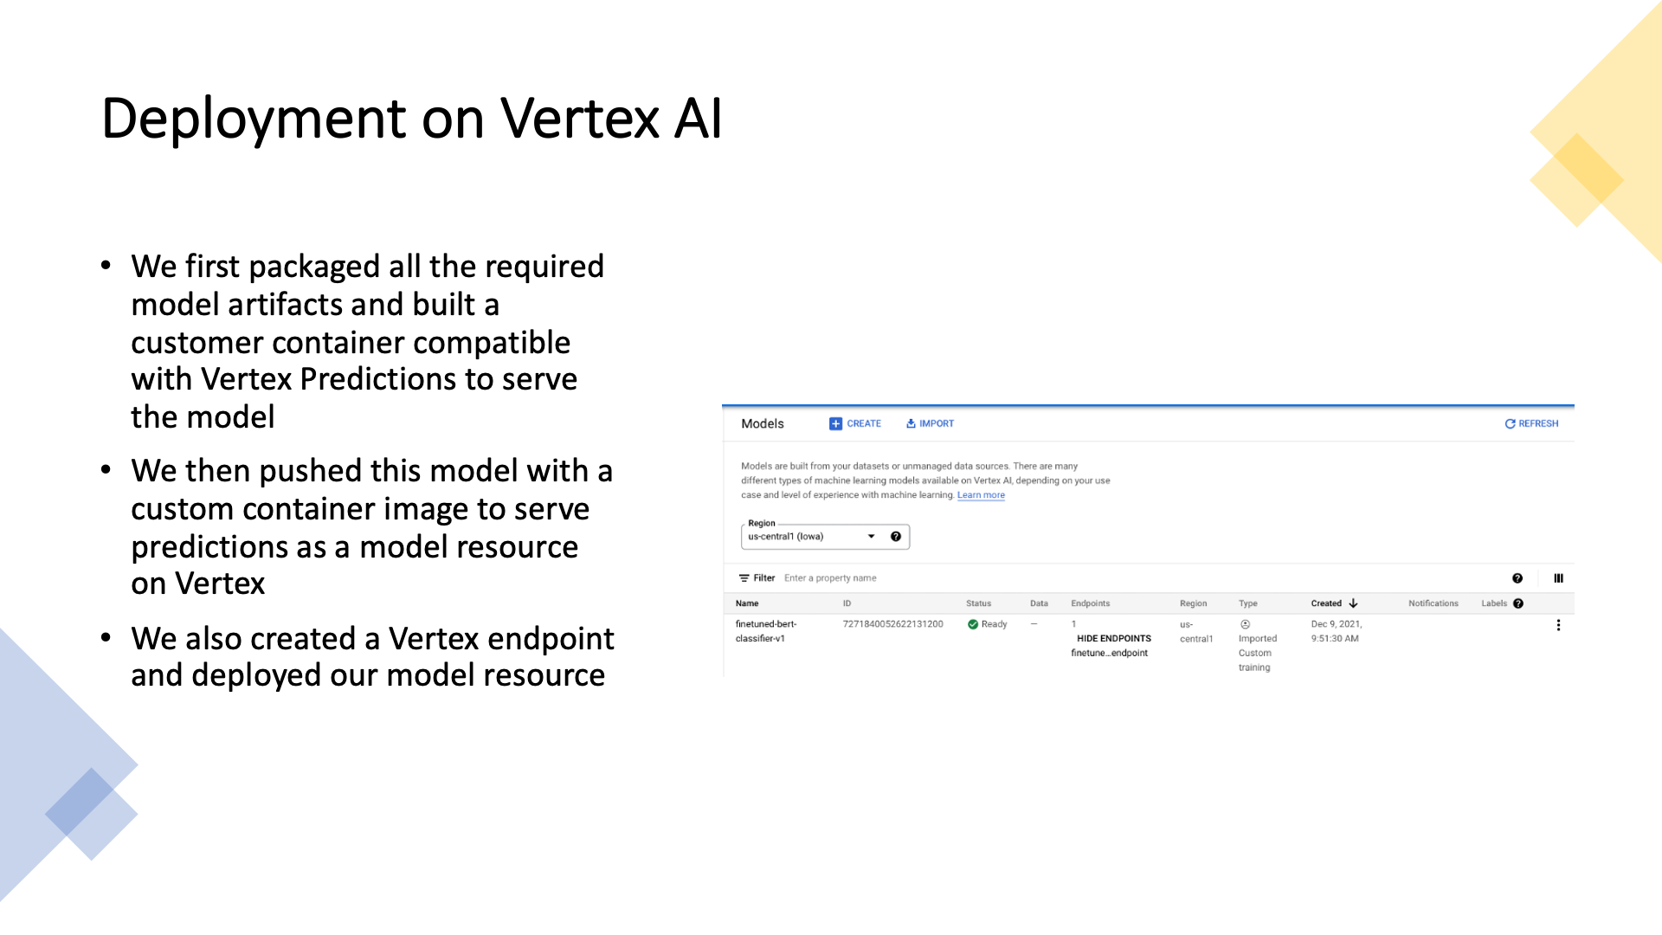

Slide 20
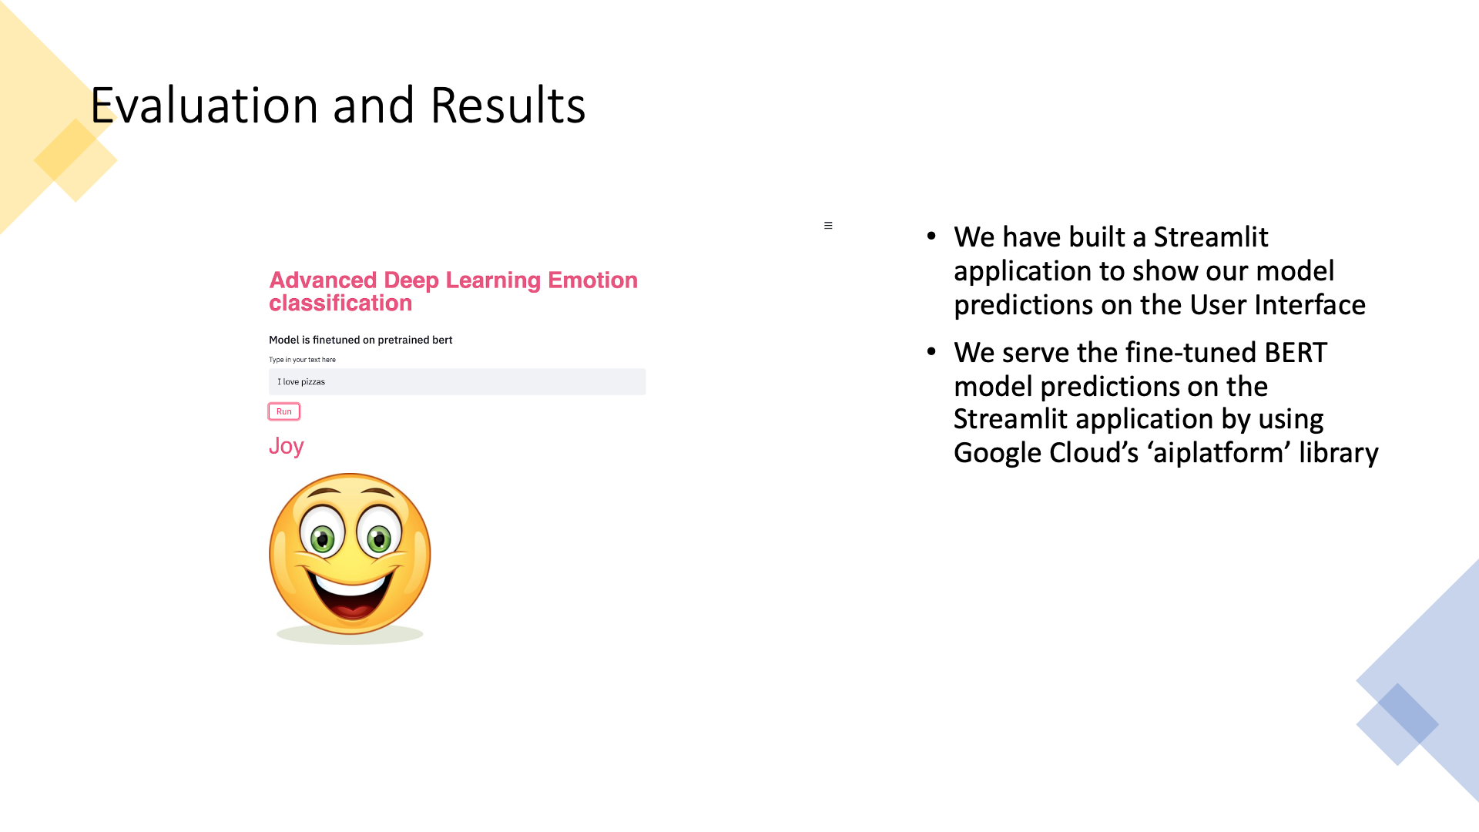

Slide 21
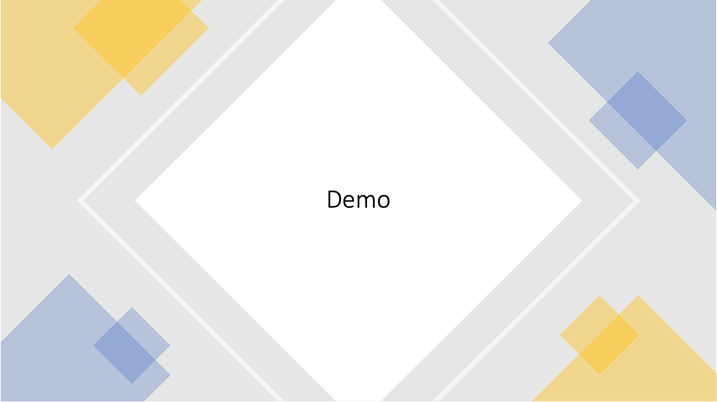

Slide 22
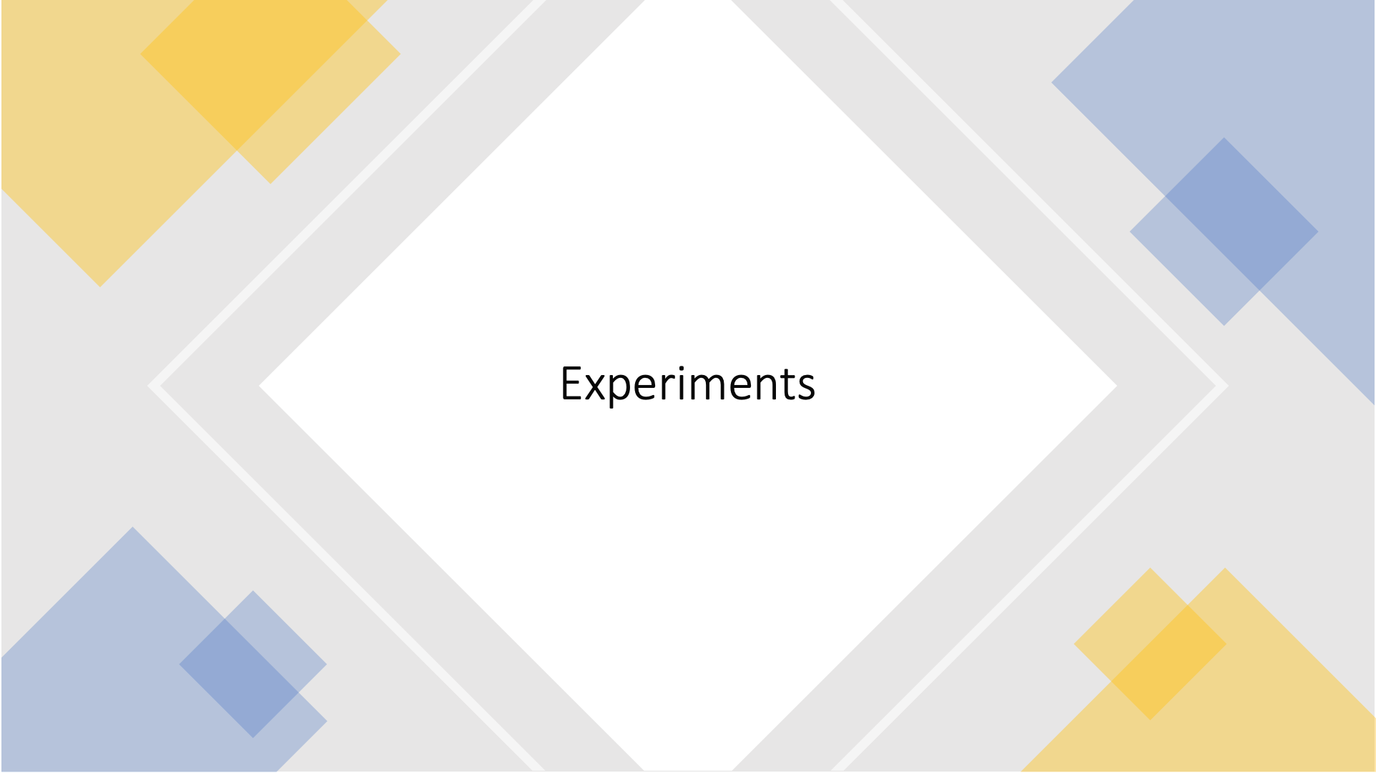

Slide 23
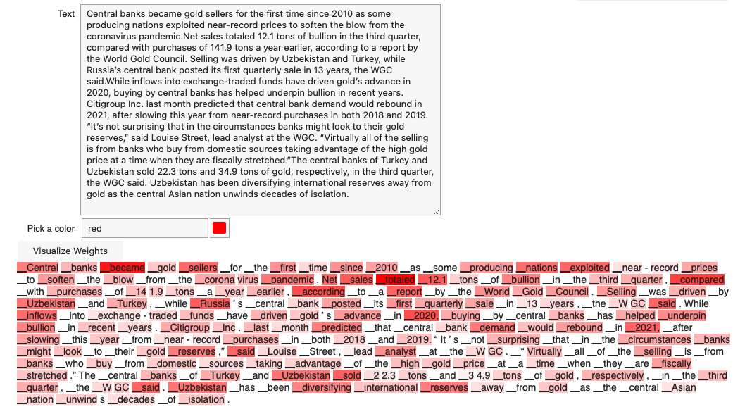
Text Summarization
Summarization is a language modeling task which shortens or surmises a text document.
Used the Pegasus model from HuggingFace which is specialized for summarizing financial statements.
Trained on Bloomberg market and financial news.
Words carrying more weight are strongly highlighted.
Used different decoding strategies
Decoding strategies include Greedy Search, Beam Search, Diverse Beam Search, Random sampling and Top k sampling.

Slide 24
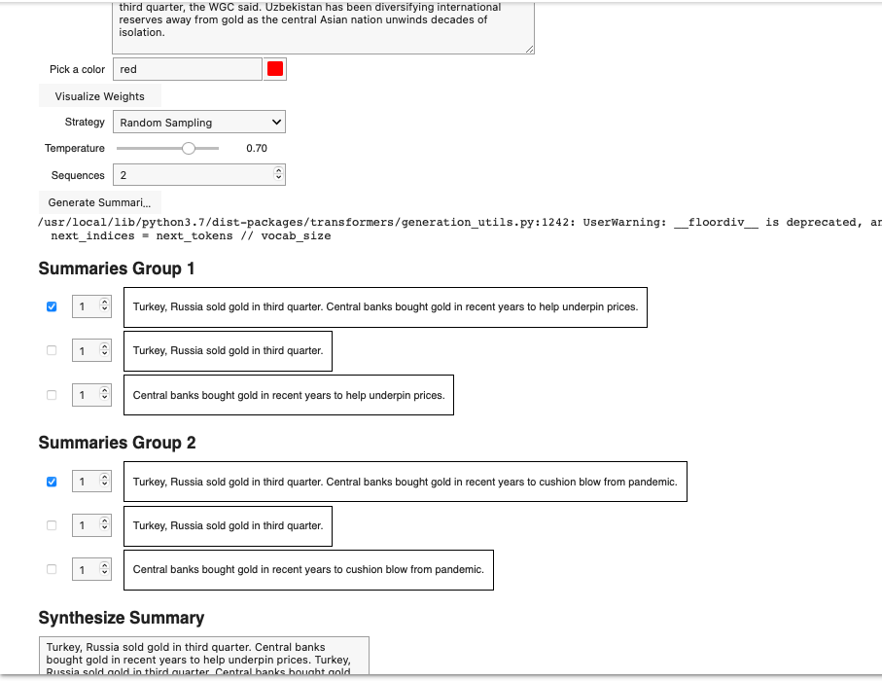
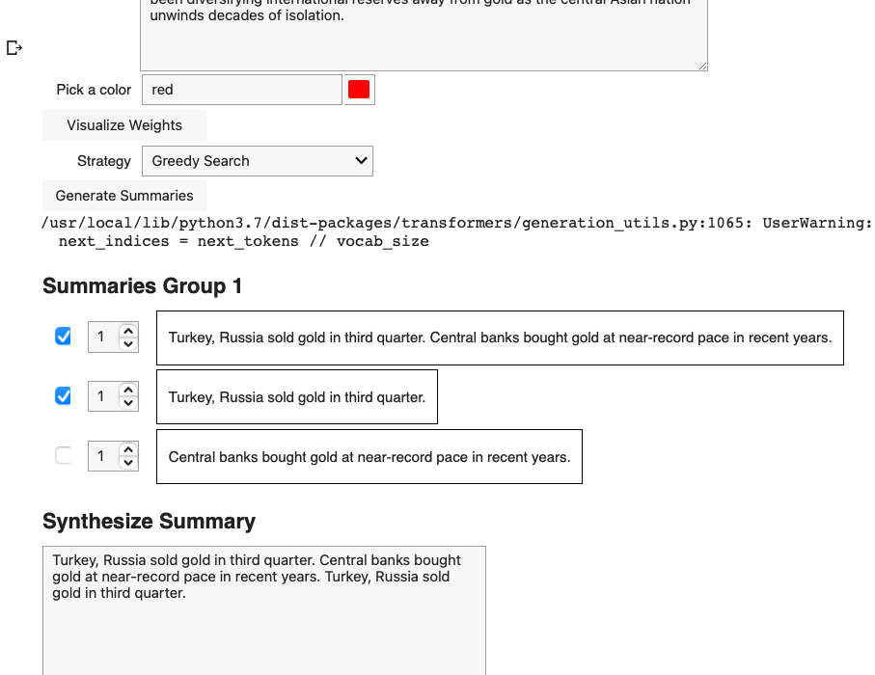
Random Sampling
Greedy Search

Slide 25
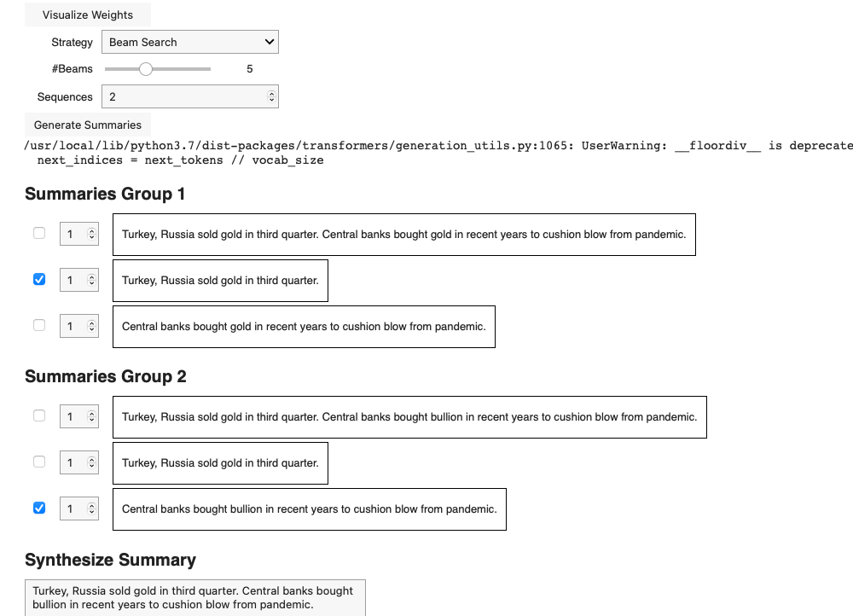
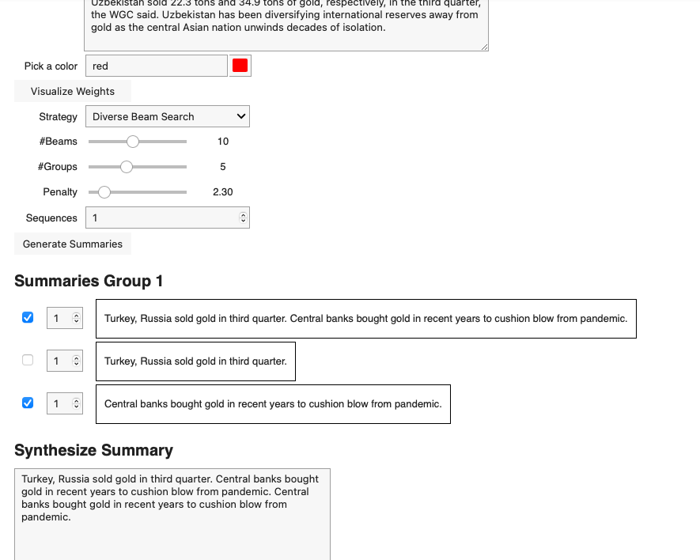
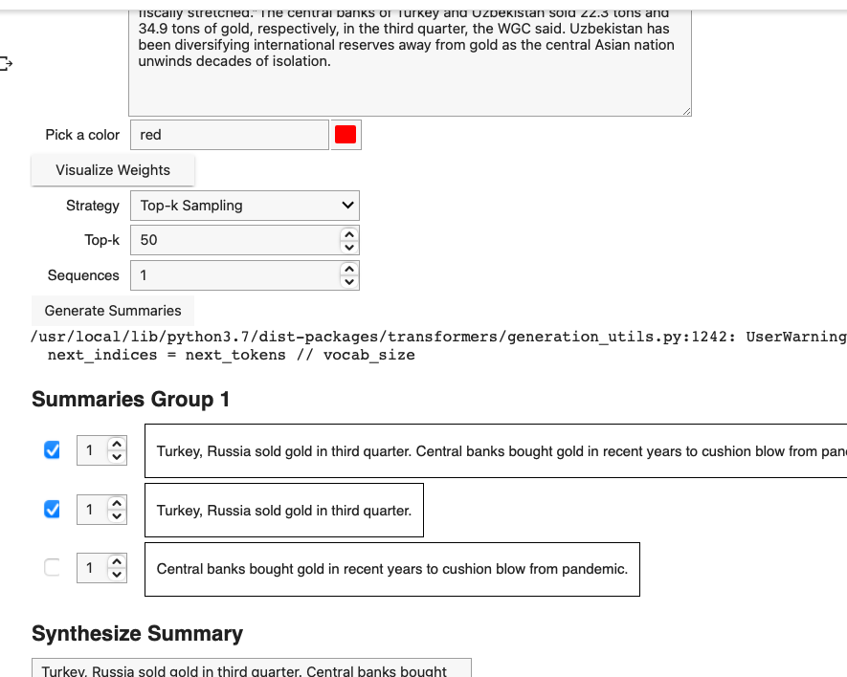
Top-k Sampling
Beam Search
Diverse Beam Search

Slide 26
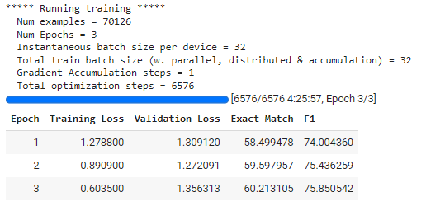
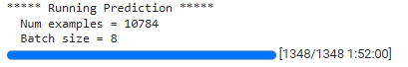
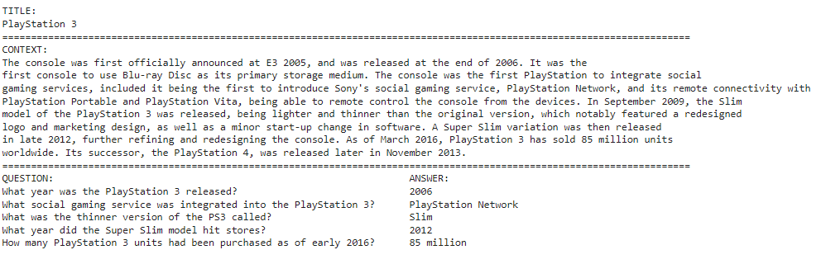
Question & Answering
Question answering is a language modeling task wherein the model is given a short paragraph or context about some topic and is asked some questions based on the passage.
We have used Transformers, specifically, the DistilBERT model, pretrained on Masked LM and Next Sentence Prediction.
Stanford Question Answering Dataset: For training, we have used the SQuAD dataset which comprises 100,000+ Questions for Machine Comprehension of Text. It is a reading comprehension dataset consisting of questions posed by crowdworkers on a set of Wikipedia articles.
We used pre-trained transformers instead of building a specific deep learning model (LSTM, CNN, etc.) which is suitable for question answering tasks is that we could do a quicker development and we could get better results by using fewer data.

Slide 27
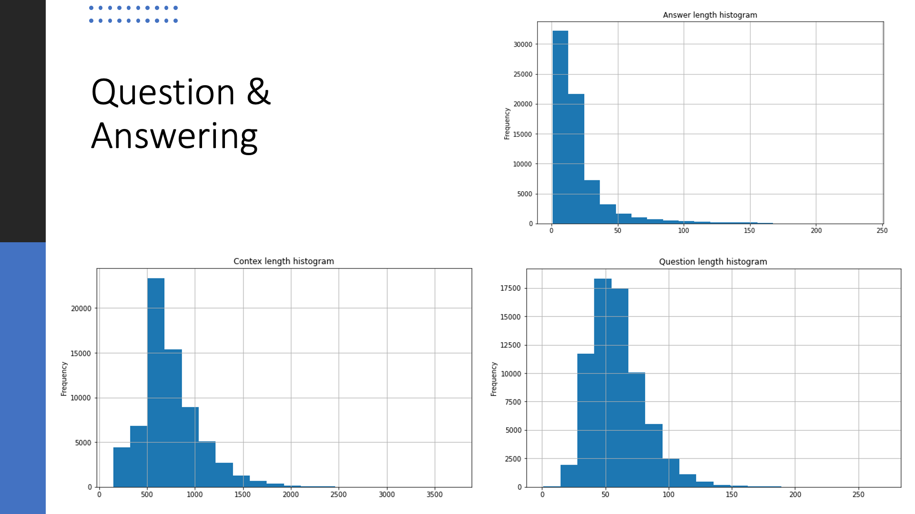

Slide 28
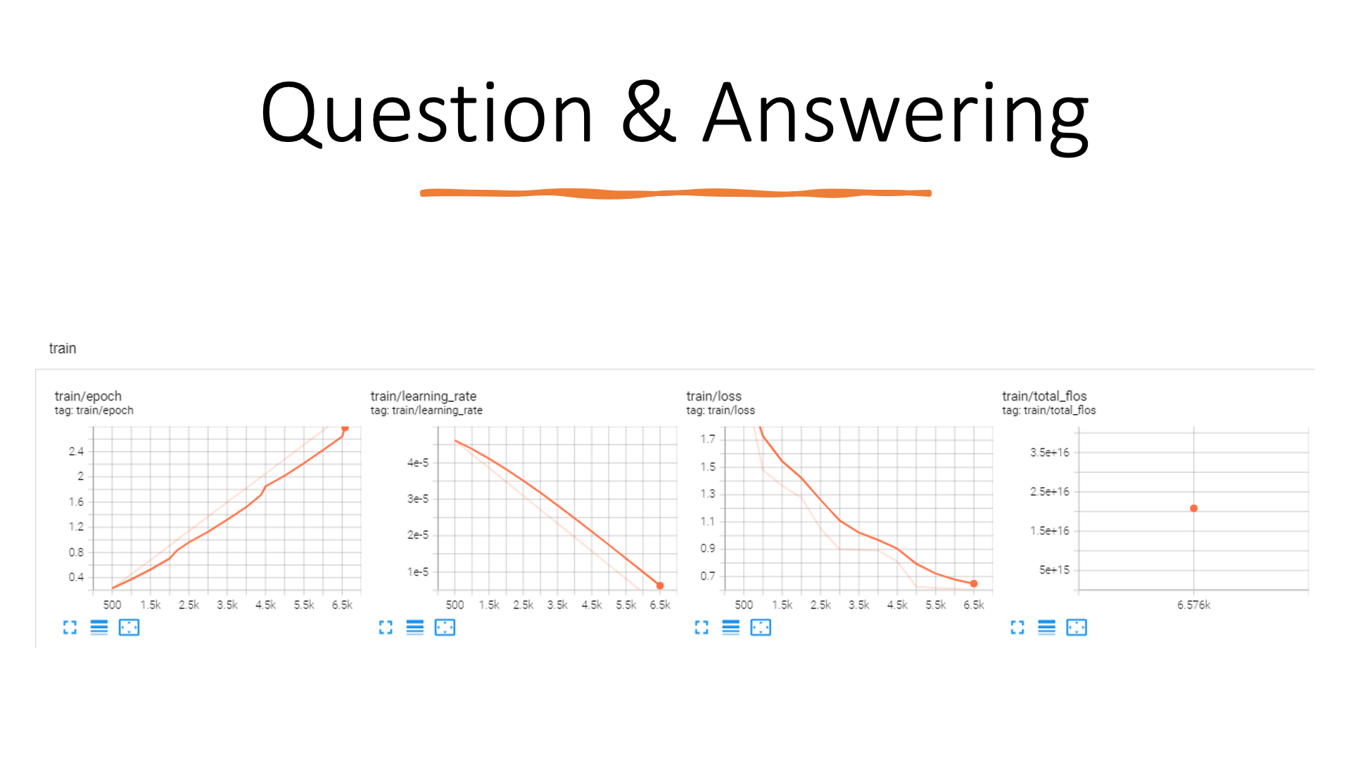

Slide 29
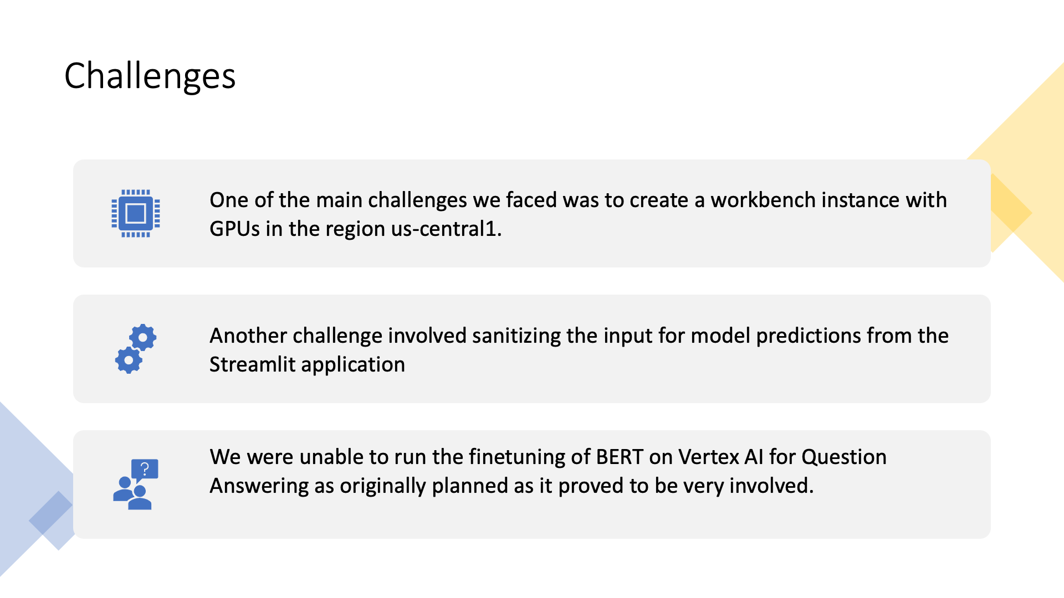

Slide 30
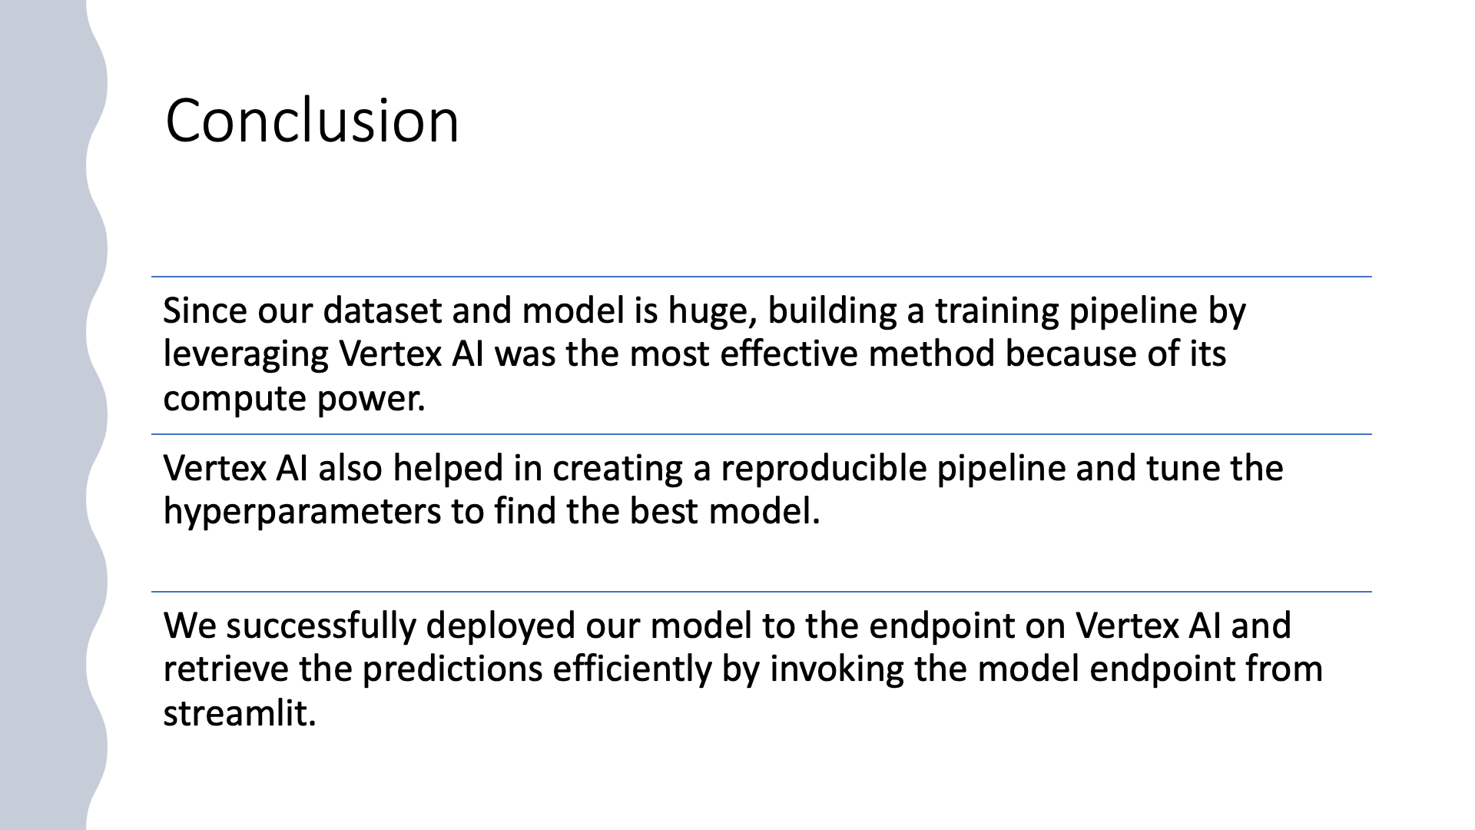

Slide 31


